Slide 1
Virtual Velocity Banking Application
Authors:
fahad hameed & Dharmesh moradiya

Slide 2
Problem: where did all my money go?
Short Answer: You spent it.
Long Answer: Wasteful spending can be reduced by having a budget…but most people don’t have time to meticulously plan out their budgets.
Solution: This application doesn’t take all the thinking out of the equation, but it does provide a visual representation of exactly where your money is going.

Slide 3
VVBank
Theme: A Banking Application that allows you to track your expenses, and get a good idea of how much money you have spent in the last few months.
Side Thought: We could redo this application to be more of a ‘Expense Tracker’ instead of going with a bank theme. Might be more relevant to the user in the end…

Slide 4
How does it work?
You enter in your transaction data. Anytime you make a transaction that removes money from your account, it will be categorized in a common group.
You can view your transaction data in a tabular format, or in a pie chart.
You can filter by date, and see expenses for the last month, three months, or the last six months.
The more data you enter, the more accurate it becomes.

Slide 5
The Plan
4 Project Phases (30 Days)
Planning – 7 Days (Nov 11 ~ Nov 18)
Sketches, Scope, Brainstorming, Feature Definition
Design – 12 Days (Nov 18 ~ Nov 25)
Implementation, Iteration, Functionality, Exception Validation
Polish – 9 Days (Nov 25 ~ Dec 4)
Review, CSS, W3C Validation, Cleanup, Prepare Presentation
Presentation – 2 Days (Dec 4 ~ Dec 6)
Presentation Dry Run / Presentation Day

Slide 6
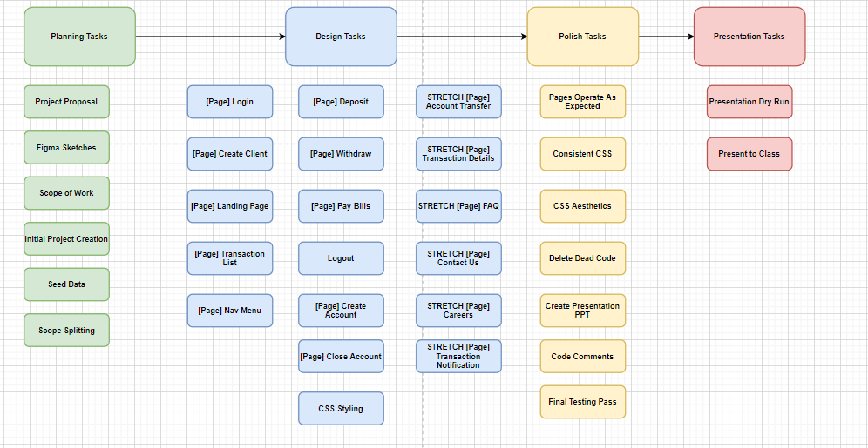
The tasks

Slide 7
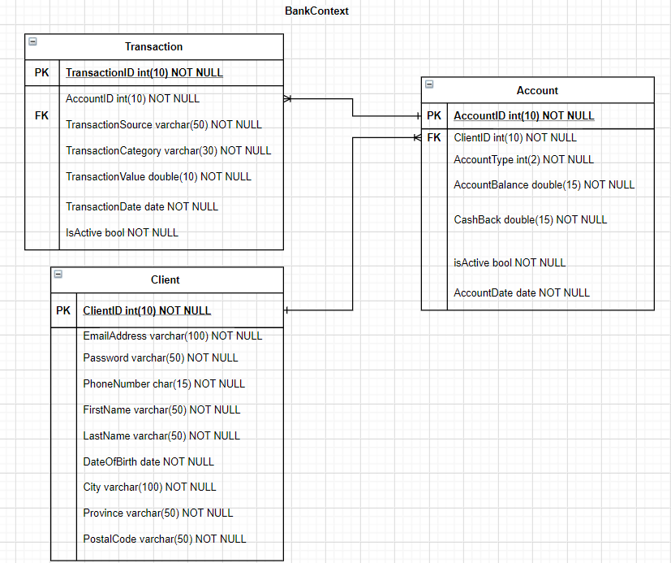
The database

Slide 8
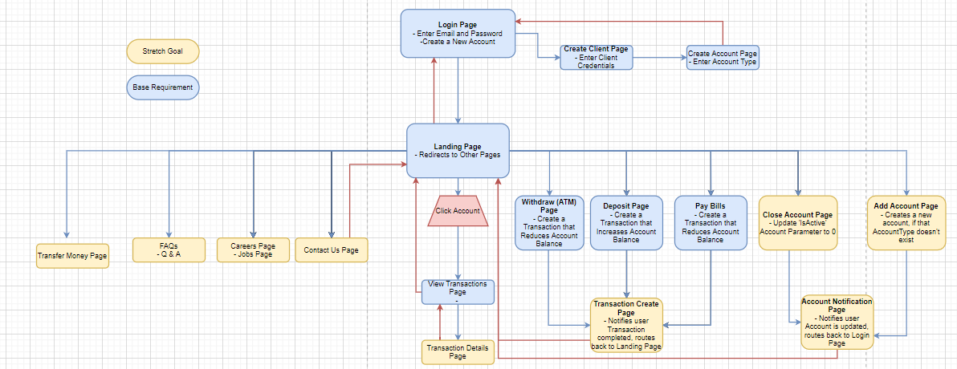
The site

Slide 9
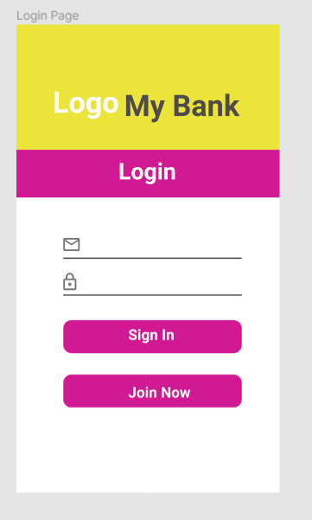
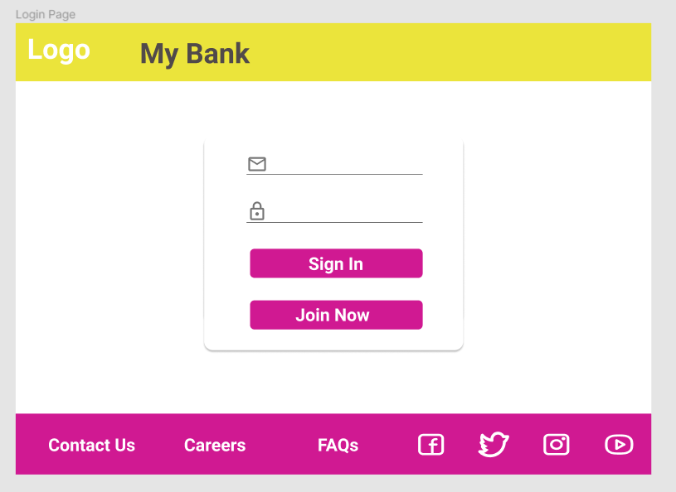
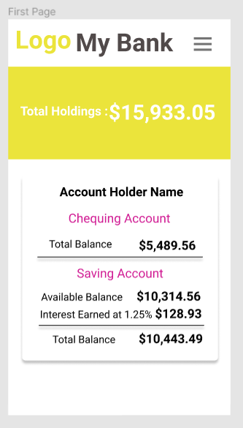
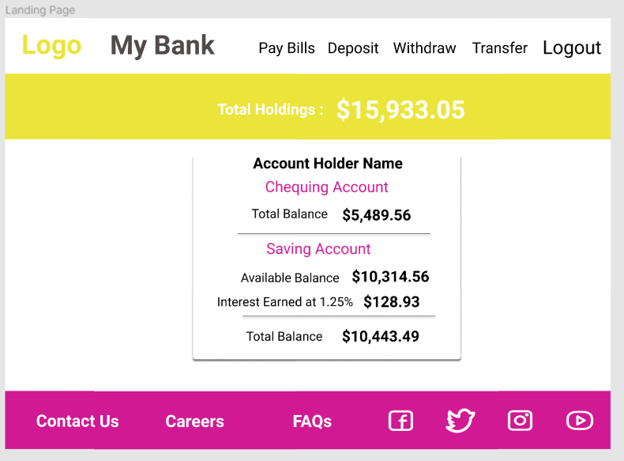
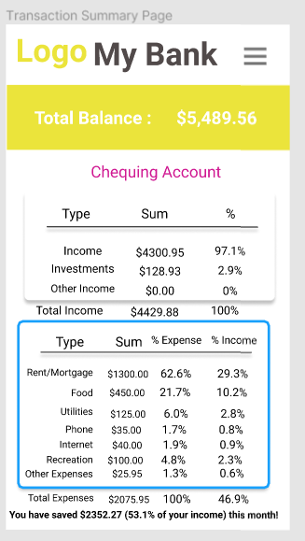
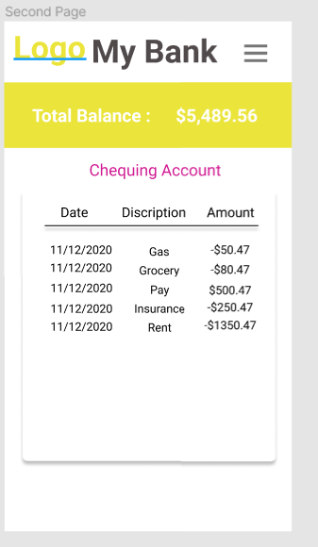
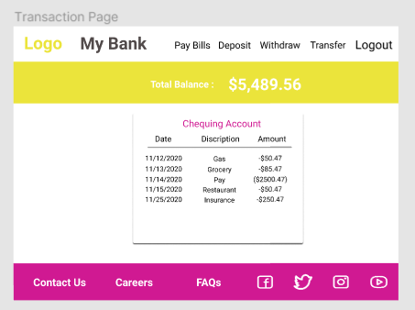
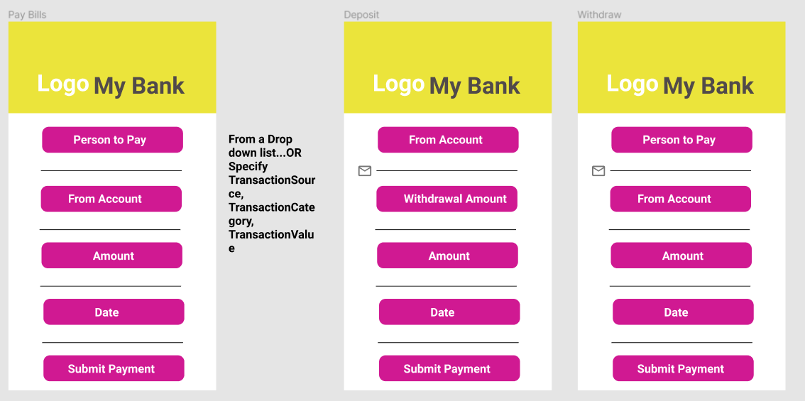
The design https://www.figma.com/file/6il3fCmu5tSvtvRl3hgCAY/Banking-Application?node-id=0%3A1

Slide 10

Live Demo!

Slide 11

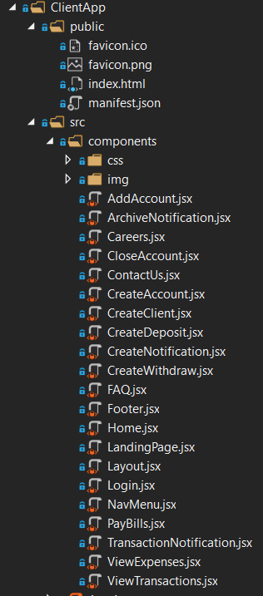
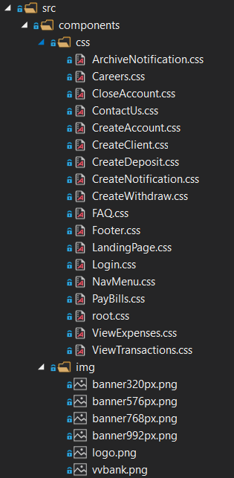
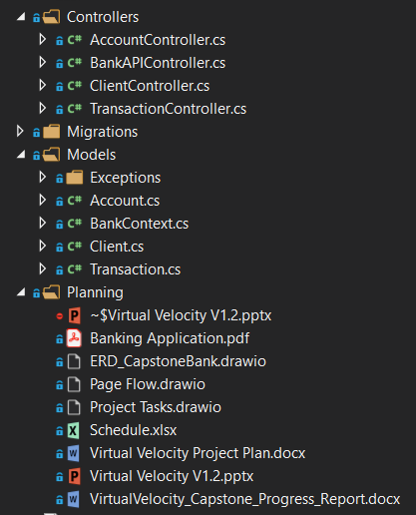
Folder Structure

Slide 12
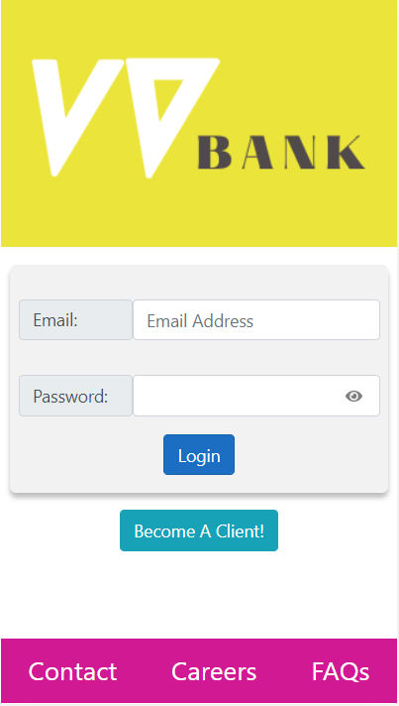
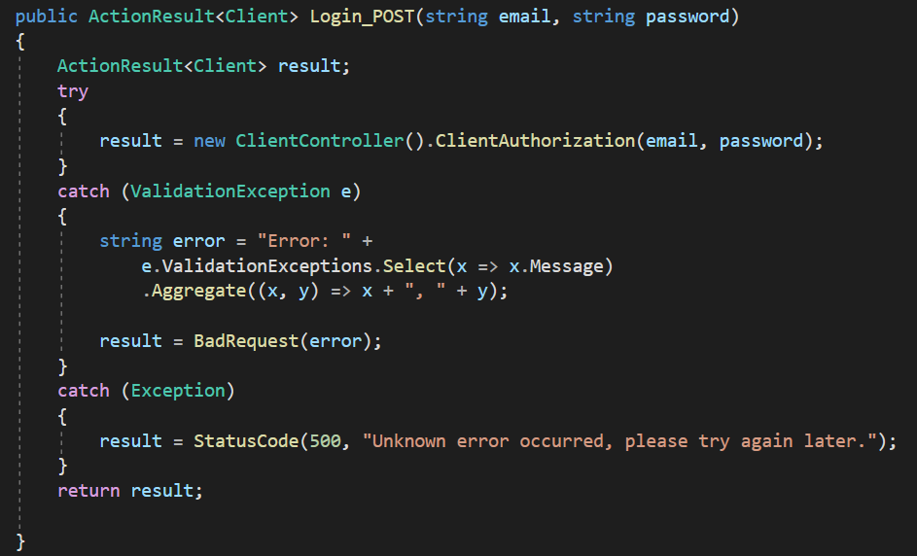
Login Page
Client sends username and Password through Http Post request
Receives two parameters at API endpoint in BankAPIController
Extra Features : Toggle Eye

Slide 13
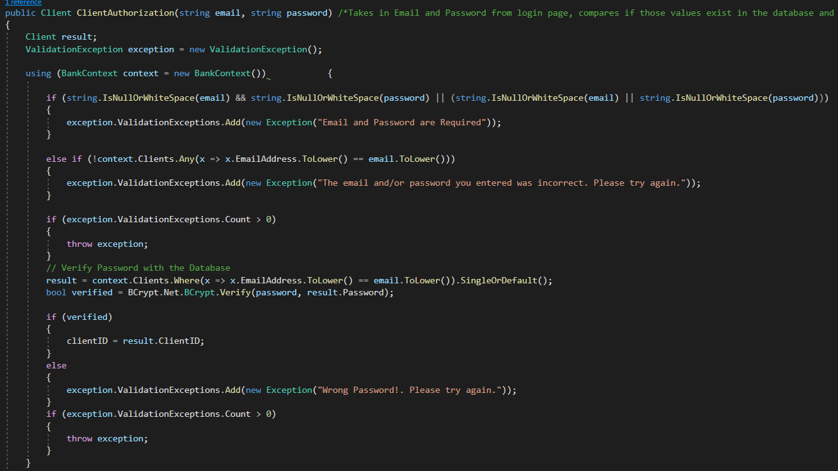
Login Page…
Check the parameters for null or whitespace. If Yes, then throws an Exception Error msg.
Second Step : Verify Password Hash in Database

Slide 14
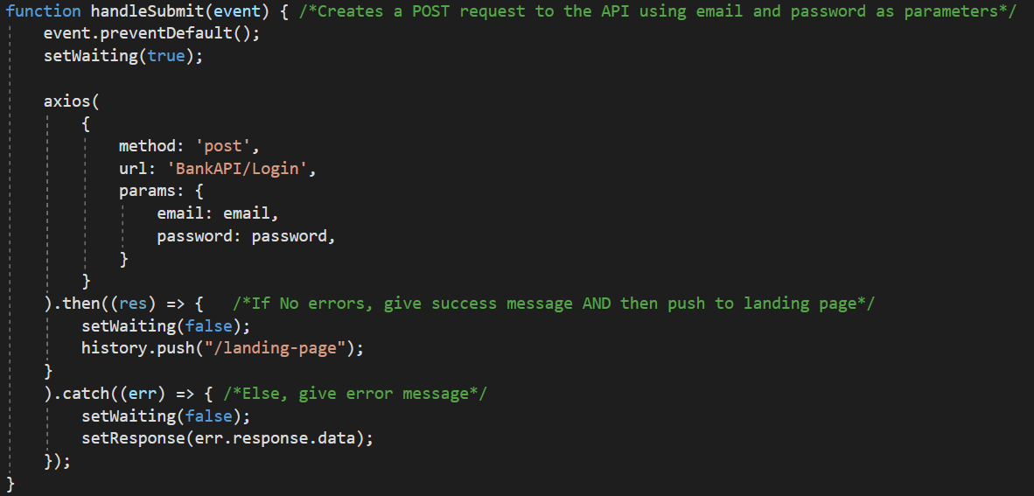
Login Page…
Used useHistory hook to route Landing Page on Successful Login

Slide 15
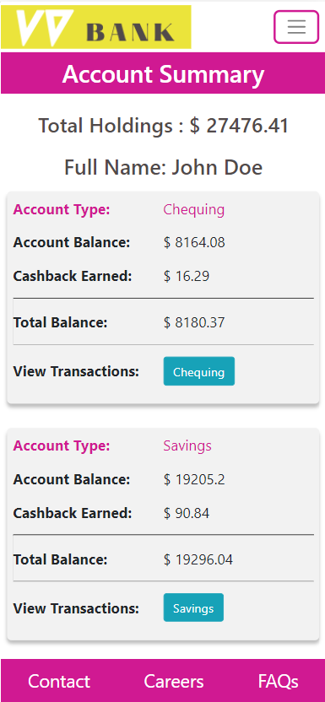
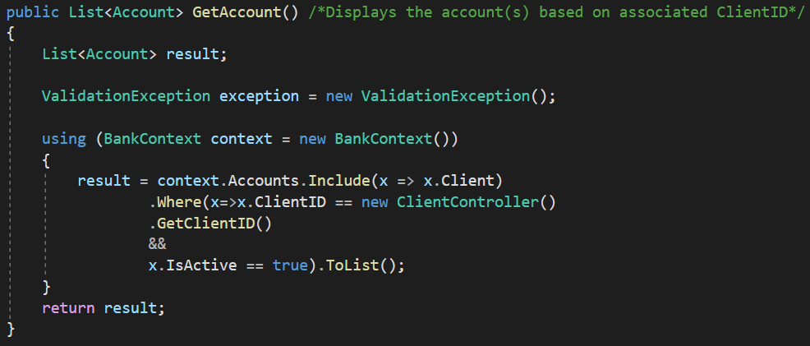
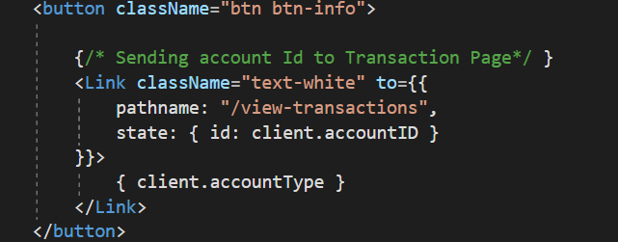
Landing Page
Get Data of the same Client through Http Get request
Used useDispatch to prevent continuous rendering.
array.map() method in JSX to populate client’s Data
array.reduce() method for total Holdings calculation
Used Link to pass props for the next Page. (ViewTransaction)

Slide 16
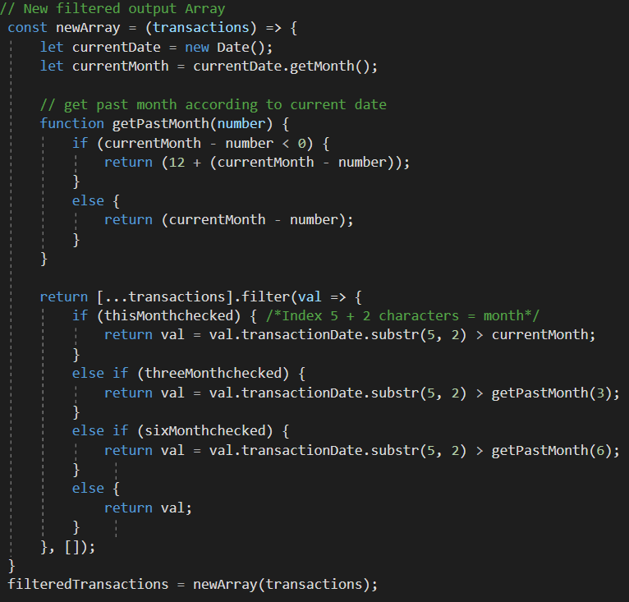
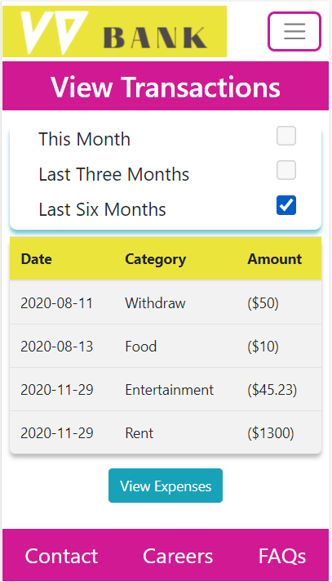
ViewTransaction Page
Get AccountID from state property
Http Get request in order to get data associated with same AccountID
Extra Features : Data filter through the Checkboxes
Pass filtered Array to next page through Link( Expenses Page )

Slide 17
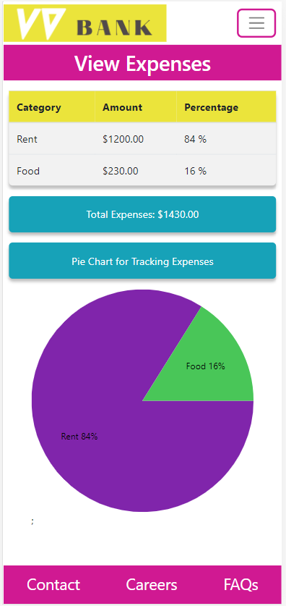
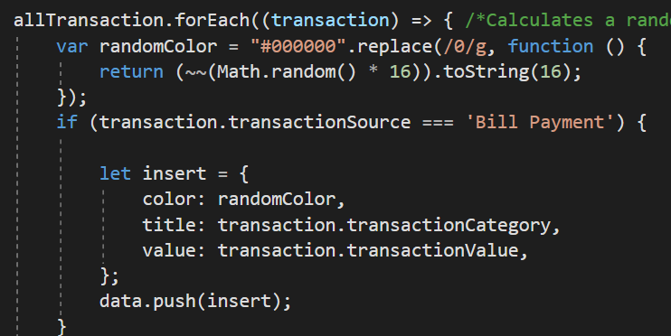
View Expenses Page
Get filtered data array from the state property
const { allTransaction } = props.location.state;
Make New array for only transactionSorce === “Bill Payment”

Slide 18
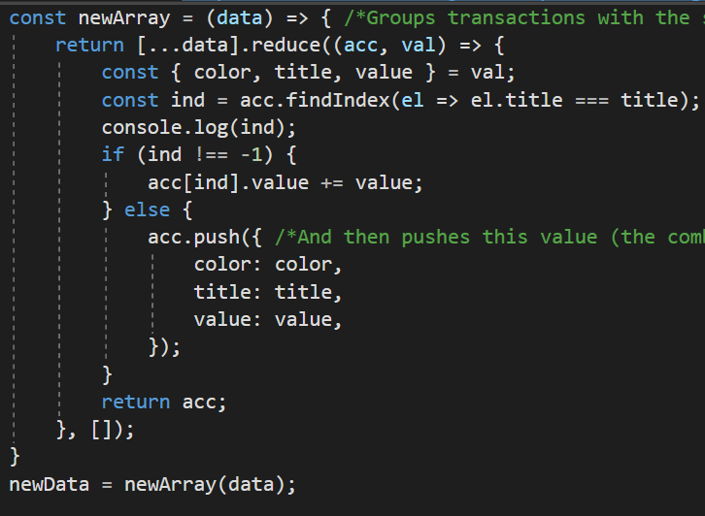
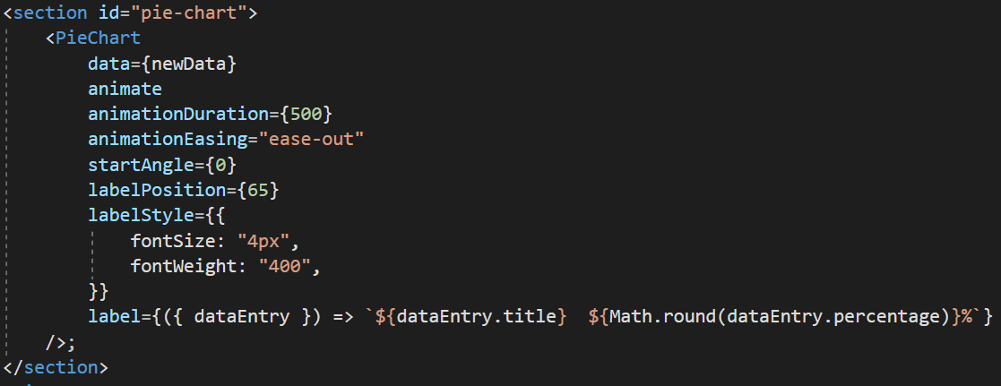
View Expenses Page…
Groups transactions with the same Category into a 'summed' variable
Push distinct value to new array.
array.map() to render Category, Amount and Percentage in JSX
Installed Pie chart:
- npm package ‘react-minimal-pie-chart';

Slide 19
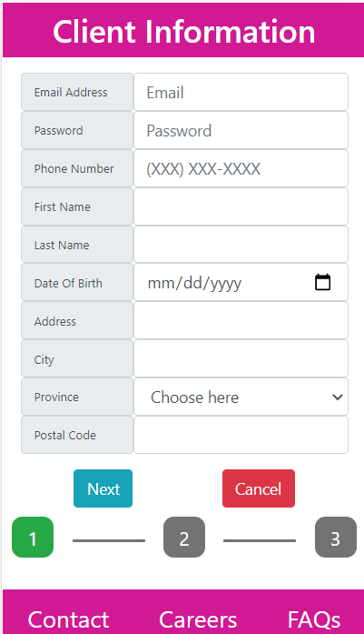
Client Information Page
Http Post Request through Axios with all the required parameters
String Validation function to validate all input at one place
Returns only trimmed whitespace and validated output
Otherwise throws an Exception
Let’s check StringValidation() in more detail.

Slide 20
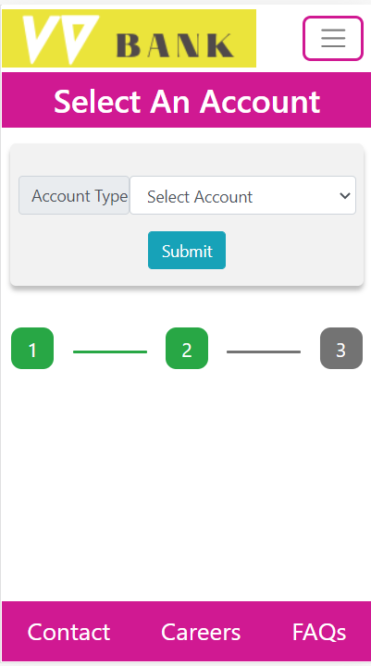
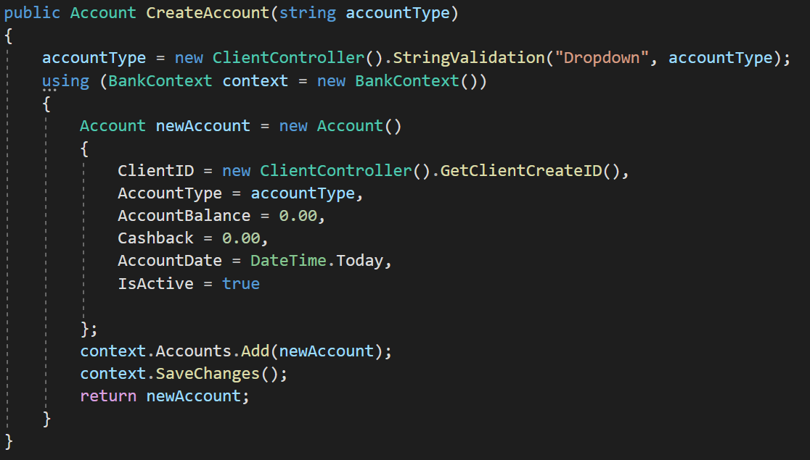
Create Account Page
Get Auto generated Client id from ClientController
Get AccountType Parameter from the user
Set other Property to their Default value

Slide 21
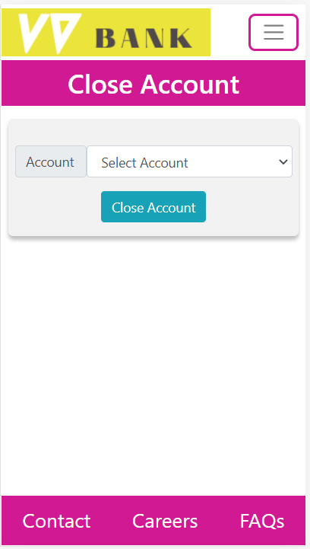
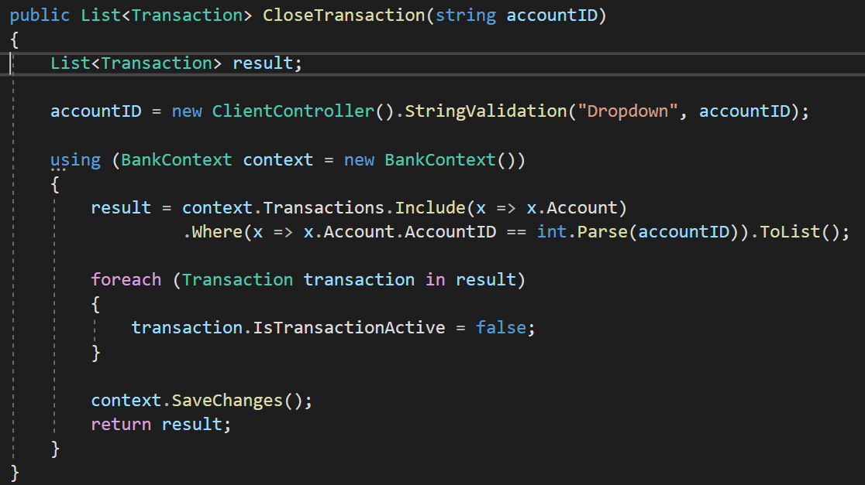
Close Account Page
Pre-Populate Account Drop down
Archive data in both tables i.e., Account and Transaction

Slide 22
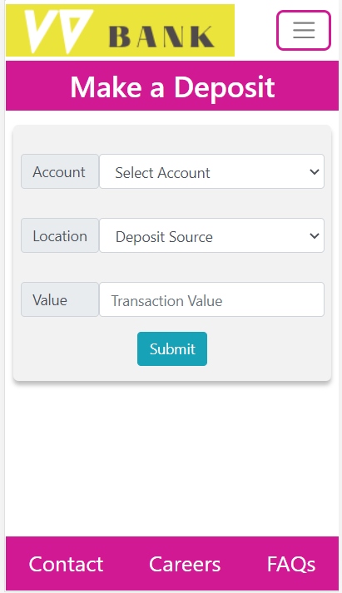
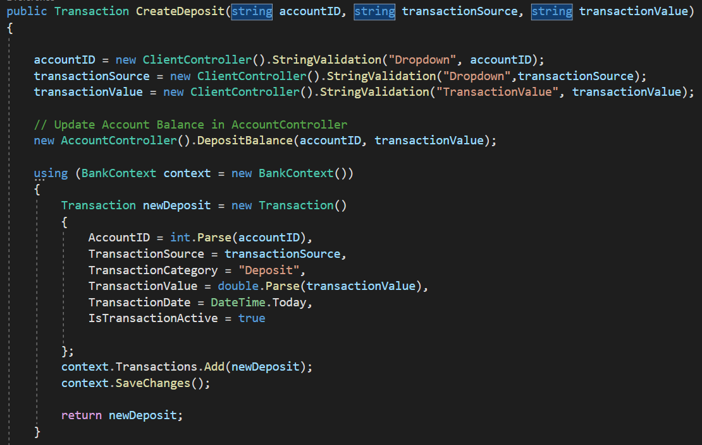
Deposit Page
First, sanitize all input with String Validation method
Second, update Account Balance
Final, If successful, then create Transaction

Slide 23
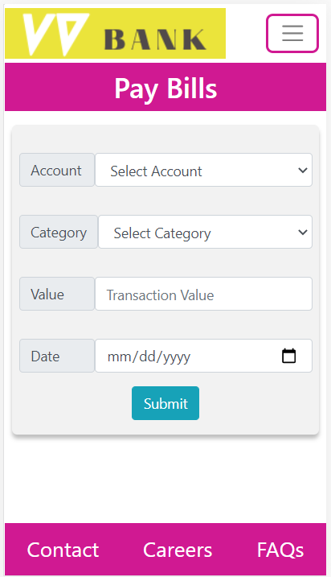
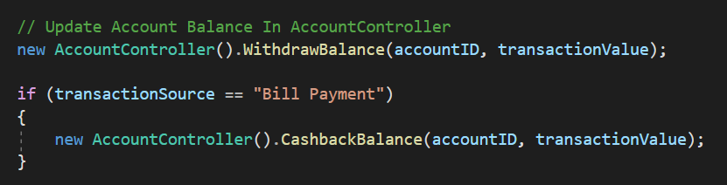
Withdraw / Bill Payment Pages
First, sanities all input with string validation method
Second, update Account Balance
Third, check for Cashback Calculation
Final, if successful, then create Transaction
Extra Features : Cashback total reaches $100 then auto adds to main balance

Slide 24
Any Questions?

